Slide 1
Pitch insensitive LSM - Convolution in f-space
Group-14
Members:
Aman Shaikh - 19D070051
Yogesh Katara- 19D070072
Harsh Choudhary- 200070023
Guide: Vivek Saraswat
Prof. Udayan Ganguly
EE746: Neuromorphic Engineering

Slide 2
Introduction
Speech recognition is a broad study area in computer science that recognizes spoken words and converts them to text
Liquid State Machines (LSMs) are brain-inspired architecture, consisting of a large recurrent network of randomly connected spiking neurons
It has various design parameters giving high flexibility for training

Slide 3
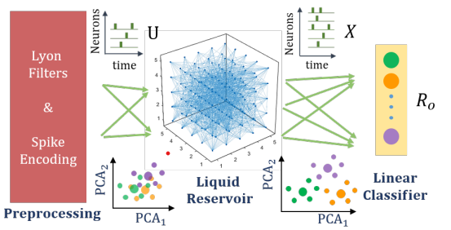
Introduction
Preprocessing: This stage consists of a cascade of a second order filters and follows BSA algorithm to get the input spikes trains. 77 spike trains were generated for a corresponding input speech sample
Liquid Reservoir: Grid of LIF neurons with fraction of excitatory and inhibitory neurons
Linear Classifier: A fully connected layer of spiking readout neurons to recognize the class of the input
Fig. 1. Implementation of LSM

Slide 4
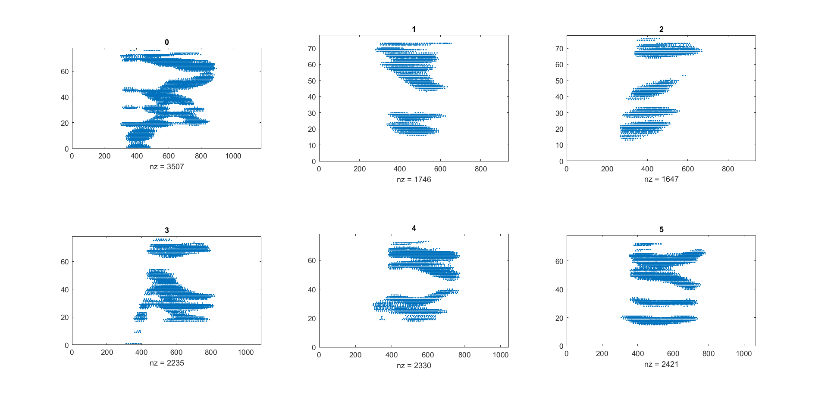
Fig. 2. Raster plots of spoken digits (0-5) for a specific speaker.

Slide 5
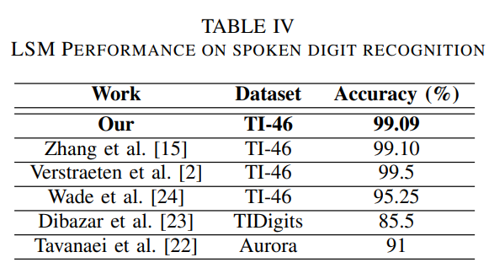
Background
In [1], the authors had perform spoken digit recognition on 500 samples from TI-46 dataset.
The samples consisted of 5 female speakers, each having 100 samples where each digit 0-9 had 10 samples each.
Reservoir size used was 5x5x5.
5 fold testing and training was used for 20 epochs.
The accuracy was obtained to be 99.09%.
Table I
Performance comparison [1]

Slide 6
Replication
The dataset and the codes from [1] obtained were run and the accuracy obtained was 98%.
The accuracy is quite high as all female speakers have high pitch.
Raster plots obtained are quite similar.
Different digits can be distinguished from their raster plots

Slide 7
Motivation & Methodology
As a next step towards modelling LSMs as pitch insensitive, the dataset used contains 4 male and 4 female speakers.
We used 800 samples from TI-46 dataset which consist of 8 speakers, each having 100 samples of digit 0-9 have 10 sample each
This samples fed to the preprocessing unit to generate the training inputs for LSMs.
Reservoir size is same as used in paper and 5 fold training and testing is used.
The accuracy obtained is 95.00%.

Slide 8
Train on one pitch and Test on another pitch
Train on mixed pitches and Test on another pitch
Training the LSM on a particular pitch/speaker does not do well when testing on a different speaker.
Test accuracy is 0% for any random case.
As the model has never seen another pitch and both the signals are uncorrelated, it will be rarely able to detect it and since the no of data points are not very large , the accuracy comes out to be 0
The raster plots look different for different pitches.
After training the model on mixed pitches, the test accuracy on the untrained pitch is 0%.

Slide 9
Effect of Liquid Reservoir size
The accuracy corresponding to the size of the reservoir is given in the table
The accuracy increased with reservoir size.
Computation time increased due to large matrices.
Reservoir Size | Accuracy(%)
5x5x5 | 95
5x5x8 | 96.25
8x5x5 | 96.75
10x5x5 | 97.5
Table II
Reservoir size vs Accuracy

Slide 10
Effect of filter size used in BSA
Ben Spiking Algorithm (BSA) is used to encode the input voice signals into spikes.
Increasing the filter size in BSA, the accuracy increased slightly.
Increasing filter size, increased spiking points in raster plots
This provides more data points for learning of LSM.
Filter Size | Accuracy (%)
97 | 97.5
193 | 97.625
577 | 97.875
Table III
Filter size vs Accuracy

Slide 11
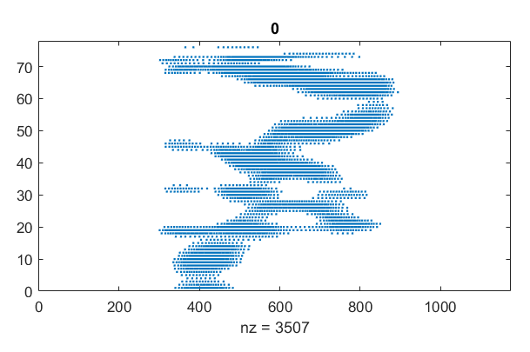
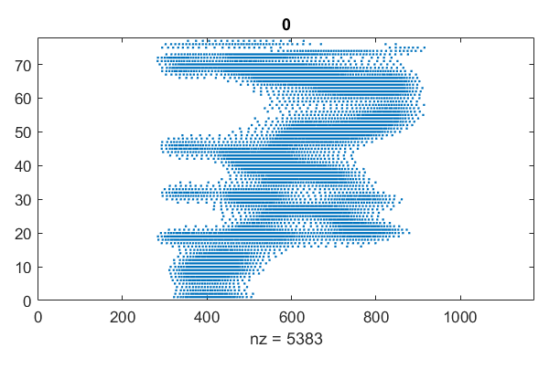
Effect of filter size used in BSA
Fig. 3. Output of BSA for same input signal with filter size of 97 and 193 respectively

Slide 12
Results and Conclusions
LSMs are useful for speech recognition as they are efficient and low power consuming due to their SNN structure.
The training dataset must have all possible pitches for the model to work.
Increasing the size of the Liquid Reservoir helps improve the accuracy.
Increasing Filter size, slightly increasing accuracy but more hardware is needed for the filter.

Slide 13
References
[1] A. Gorad, V. Saraswat and U. Ganguly, "Predicting Performance using Approximate State Space Model for Liquid State Machines," 2019 International Joint Conference on Neural Networks (IJCNN), 2019, pp. 1-8, doi: 10.1109/IJCNN.2019.8852038.

